Slide 1
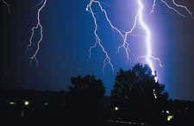
Weather Patterns
Data Analytics and Visualization Final Project
John Bates | Brittany Woolard | Danielle Duce | Lakenia Manago

Slide 2
Purpose
Analyze weather patterns among the east coast
Predict the likelihood of bad weather
Provide analysis for meteorologist

Slide 3
Data Exploration Phase
Questions we want to answer
Finding the best data the fits what we need

Slide 4
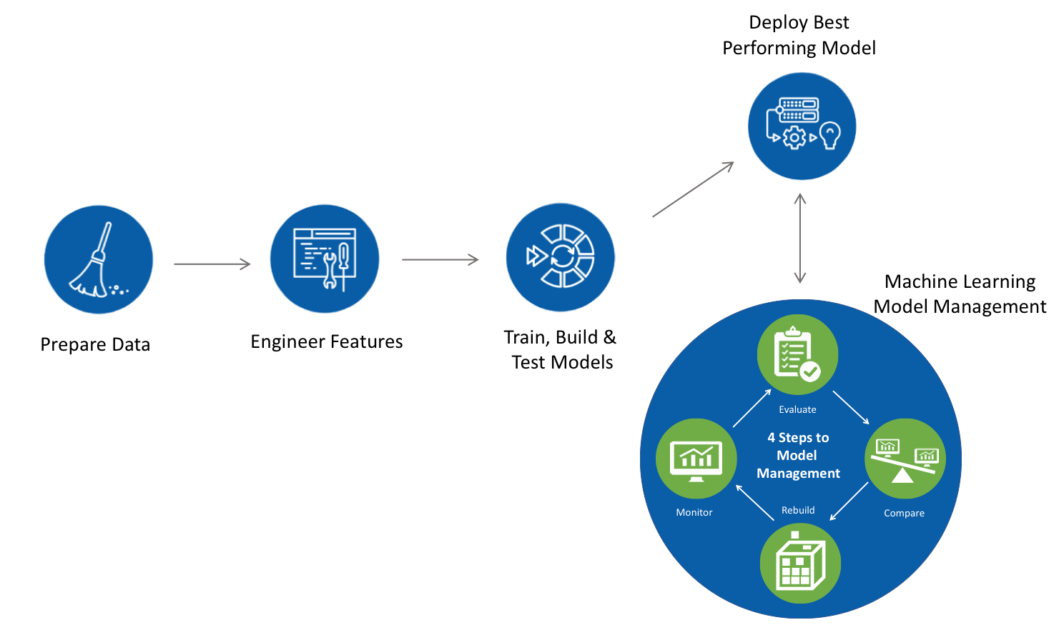
Machine Learning Pipeline

Slide 5
Database Structure
Entity Relationship Diagram

Slide 6
Data Analysis
Visualize the Data
Tableau Dashboard
Notes:
Final_Project_Visuals - Danielle Duce | Tableau Public

Slide 7

Data Analysis
Finding the geohash
Notes:
Process to find the Geohash for storms

Slide 8
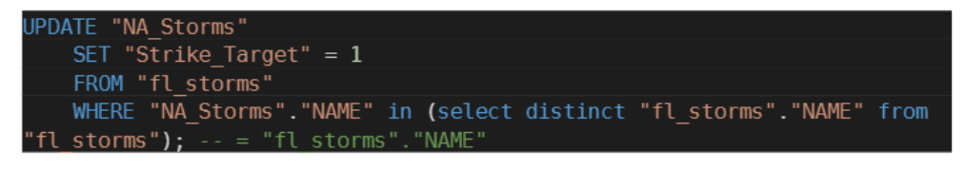
Data Analysis
Strike Target
Notes:
Set value of “Strike_Target” to 1 if exists in “fl_storms” table. Note, a 1 in the
Strike_Target column indicates a storm strike in the target area

Slide 9

Data Analysis
Logistic Regression Model
Notes:
Based on the Logistic Regression Learning Model we have an accuracy score of 70%. For this machine learning model we used sklearn.preprocessing.

Slide 10
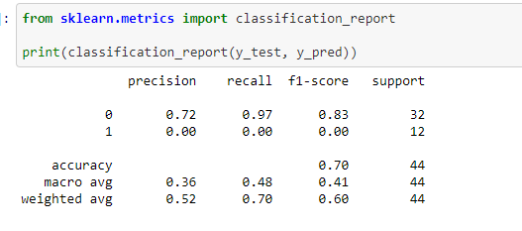
Data Analysis
Cont’d Logistic Regression Model
Notes:
Based on the Logistic Regression Learning Model we have an accuracy score of 70%. For this machine learning model we used sklearn.preprocessing.

Slide 11
Tools Used
Creating Database
PostgresSQL
CSV
- Connecting to Database
- SQLAlchemy, Psycopg2 module
Analyzing Data
Pandas
Machine Learning
sklearn.preprocessing
Dashboard
Tableau

Slide 12
Recommendations for Future Analysis
Explore other feature for correlation
Make other analysis based on the severity of the storm

